Slide 1
Paper Presentation
CSE-713
Mustansir Mashruk Rahman
Student ID: 22366008

Slide 2
Heart failure survival prediction using machine learning algorithm: am I safe from heart failure?
By Muntasir Mamun,
Afia Farjana,
Miraz Al Mamun,
Md Salim Ahammed,
Md Minhazur Rahman

Slide 3
Abstract
Heart Failure (HF) is a prevalent ailment worldwide, and despite significant medical advancements in the past few decades, cardiovascular disease is still the leading cause of death.
Because so many elements involved to a patient developing HF, without using computational technique, giving proper care to HF patients can be difficult for physicians.
This study aims to develop prediction models for patient survival in HF conditions.
In this paper, the authors analyzed the UCI heart failure dataset containing relevant medical information of 299 HF patients.

Slide 4
Abstract
The authors applied several machine learning classifiers to predict the patient survival from HF-related pathophysiological parameters.
Machine learning classifiers used in this publication:
Logistic Regression
Decision Tree
Support Vector Machine
XGBoost
LightGBM
Random Forest
KNN
Bagging

Slide 5
Abstract
This paper also presents a comparative study by analyzing the performance of different machine learning algorithms.
Their analysis indicates that LightGBM achieved the highest Accuracy of 85% and AUC of 93% in predicting patient survival of HF patients compared to other machine learning algorithms

Slide 6
Introduction
Heart failure is a debilitating condition in which the heart fails to pump enough blood to meet body demands resulting in multiple organ failures and death
Heart failure affects roughly 26 million individuals worldwide, accounting for more than 10% of overall health expenditures for cardiovascular disorders in the United States.

Slide 7
Introduction
There are a wide range of factors including but not limited to-
Poor diet
Sedentary lifestyle
Drug abuse or alocoholism,
Pre-existing medical conditions (eg diabetes, high blood pressure, hypercolestoerolemia)
Physiological disorders (hormonal imbalance, vitamin level changes), and
Therapeutic intervention (radiation or chemotherapy)
can contribute to CVD

Slide 8
Introduction
Machine learning models are increasingly being used in predicting disease conditions and relevant healthcare outcomes.
The importance of ML in detecting hidden discrete patterns and analyzing the data is critical since it can successfully predict heart failure and survival.

Slide 9
Dataset Information
The dataset has been collected from UCI Machine Learning Repository. This dataset contains the medical records of 299 heart failure patients who were followed up during their treatment, with each patient profile containing 13 clinical features.
Of the 13 attributes, 12 attributes are predictive or independent variable and 1 target variable (Death event).
The features are explained in the following slide-

Slide 10
Dataset Information
Attribute Name (Feature variables) | Attribute Information
1. Age | Age of the patient (years)
2. Anemia | Decrease of red blood cells or hemoglobin (Boolean)
3. High blood pressure | If the patient has hypertension (Boolean)
4. Creatinine phosphokinase (CPK) | Level of the CPK enzyme in the blood (mcg/L)
5. Diabetes | If the patient has diabetes (Boolean)
6. Ejection fraction | Percentage of blood leaving the heart at each contraction (percentage)
7. Platelets | Platelets in the blood (kilo platelets/mL)
8. Sex | Woman or man (binary)
9. Serum creatinine | Level of serum creatinine in the blood (mg/dL)
10. Serum sodium | Level of serum sodium in the blood (mEq/L)
11. Smoking | If the patient smokes or not (Boolean)
12. Time | Follow-up period (Days)
13 Death event [Target ] | If the patient deceased during the follow-up period (Boolean)

Slide 11
Methodology
Firstly, the authors collects the dataset from UCI Machine Learning Repository website [24], which has 299 instances with 13 attributes.
Dataset pre-processing: The dataset has been pre-processed by several approaches such as –
features extraction
missing values handling by cleaning the data
categorical variables transformation, respectively.
The paper’s dataset is unbalanced as small. For this reason, the paper used the oversampling approach by SMOTE [21] to make the dataset balanced. Hence, they get a more appropriate performance output along with zero biasness with the validation.

Slide 12
Methodology
The authors chose the K-fold cross-validation method for their heart failure dataset.
K-fold cross-validation is a significant method for getting an appropriate output for a small dataset [22].
The authors used K=10 for the validation, where K represents number of folds.
After validating the loop 10 times, the authors found their mean model scores such as Accuracy, Precision, Recall, F1-Score, and Area under the curve (AUC) for each machine learning classifier.

Slide 13
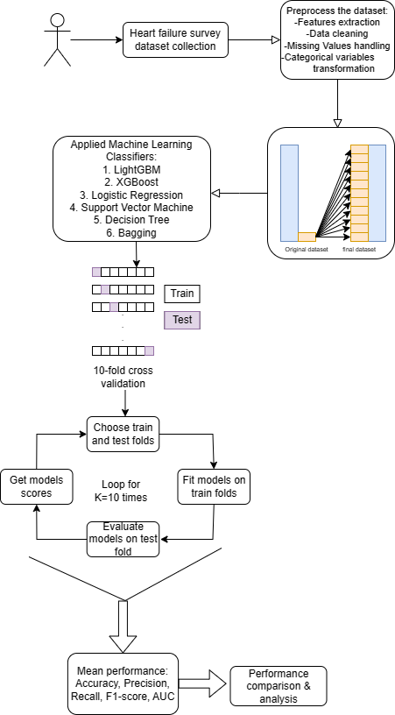
Methodology
Overview of the study in a flow chart

Slide 14
Results and Discussion: Table III: Values of different measures for different machine learning classifiers for predicting the survival of HF
Machine Learning model | Accuracy (%) | Precision (%) | Recall (%) | F1-score (%) | AUC (%)
1. Logistic Regression | 80.00 | 80.70 | 80.84 | 80.00 | 89.44
2. Support Vector Machine | 73.22 | 71.00 | 81.00 | 75.00 | 86.30
3. XGBoost | 84.00 | 85.25 | 82.61 | 83.50 | 92.00
4. LightGBM | 85.00 | 87.27 | 82.64 | 84.55 | 93.00
5. Decision Tree | 73.21 | 73.00 | 74.11 | 73.00 | 73.20
6. Bagging | 82.00 | 88.36 | 75.36 | 70.10 | 89.05

Slide 15
Results and discussion: Fig 3: Accuracy analysis for predicting the HF using machine learning models
85
84
Accuracy Score (%)

Slide 16
Results and discussion: need for AUC in addition to accuracy
Accuracy cannot be the only metric for analyzing the performance of the models
the Area under curve (AUC) value, which evaluates a model's performance to distinguish across classes, becomes a significant matrix for assessing the model's performance
The AUC measures how successfully a model can distinguish between positive and negative classifications

Slide 17
Results and discussion: Fig 5: Area under curve (AUC) analysis for predicting the heart failure using machine learning models
93
92
Area under curve(%)

Slide 18
Criticism
The sample size of the data is small, with only 299 samples. That influences the research’s reliability.
The paper’s conclusion hasn’t been applied to real life. So it cannot be said the accuracy will be shown in real life application.
The dataset is imbalanced. So the result may contain bias.

Slide 19
Thank You
For your patience

